Slide 1
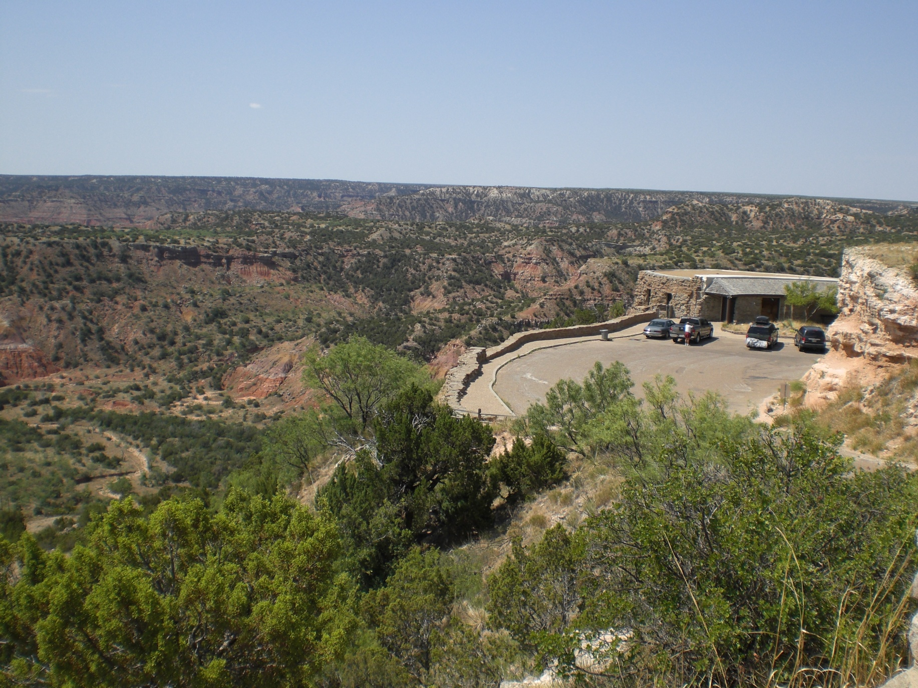
Virtual Road Trips

Slide 2
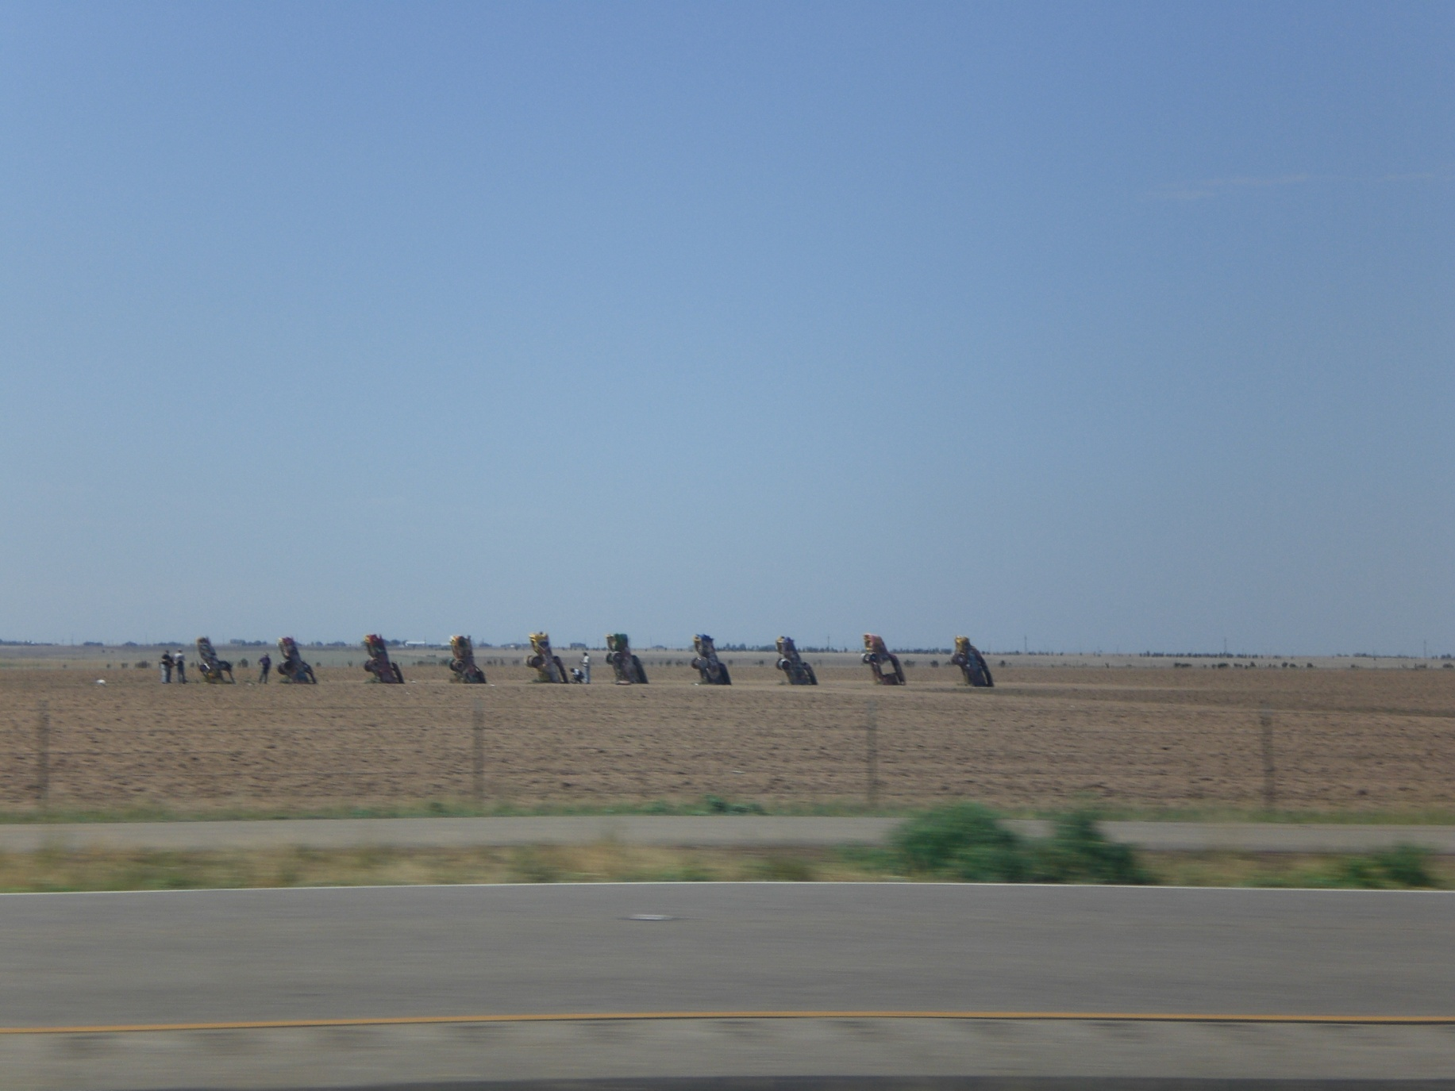
Virtual Road Trips

Slide 3

Virtual Road Trips

Slide 4

Virtual Road Trips

Slide 5
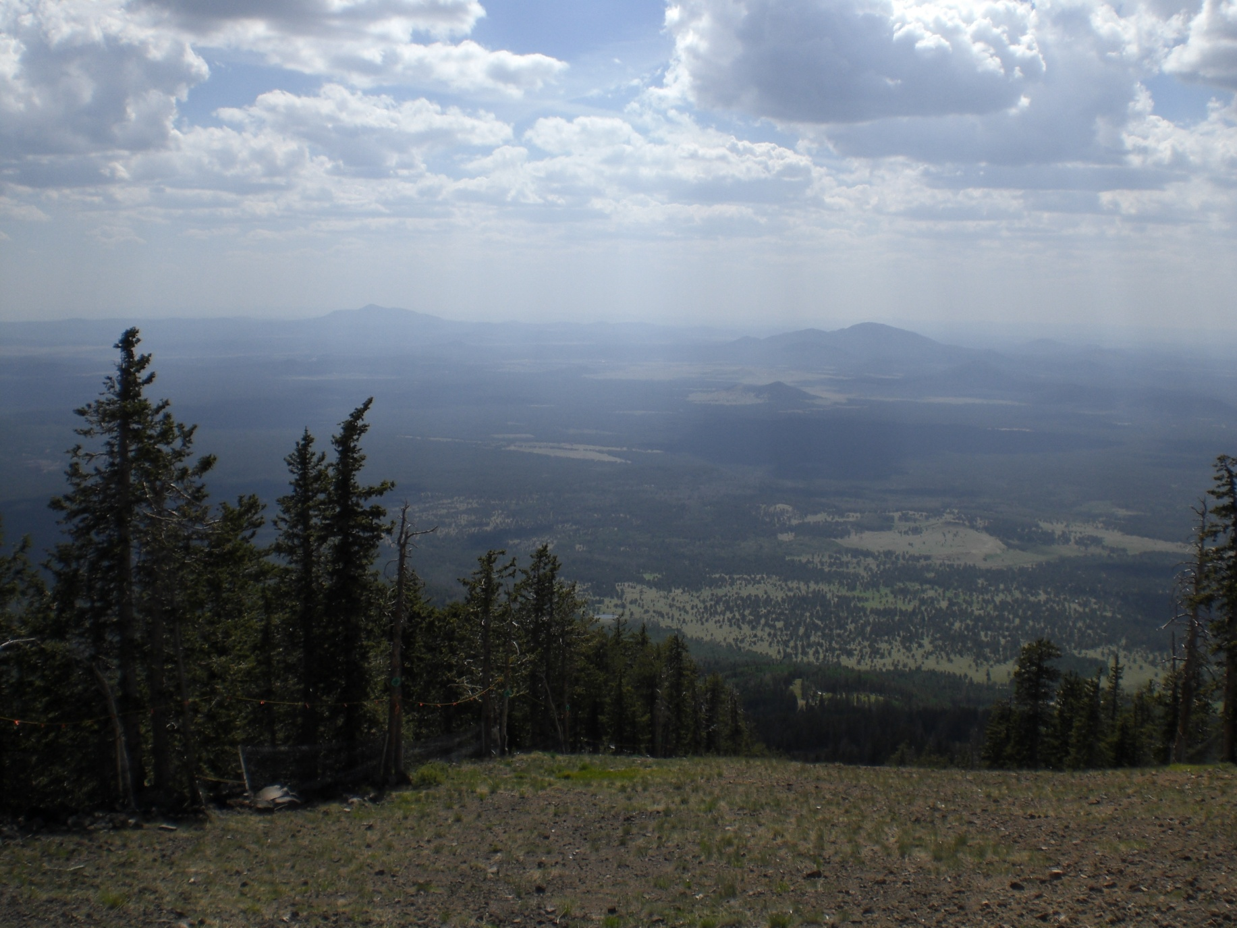
Virtual Road Trips

Slide 6
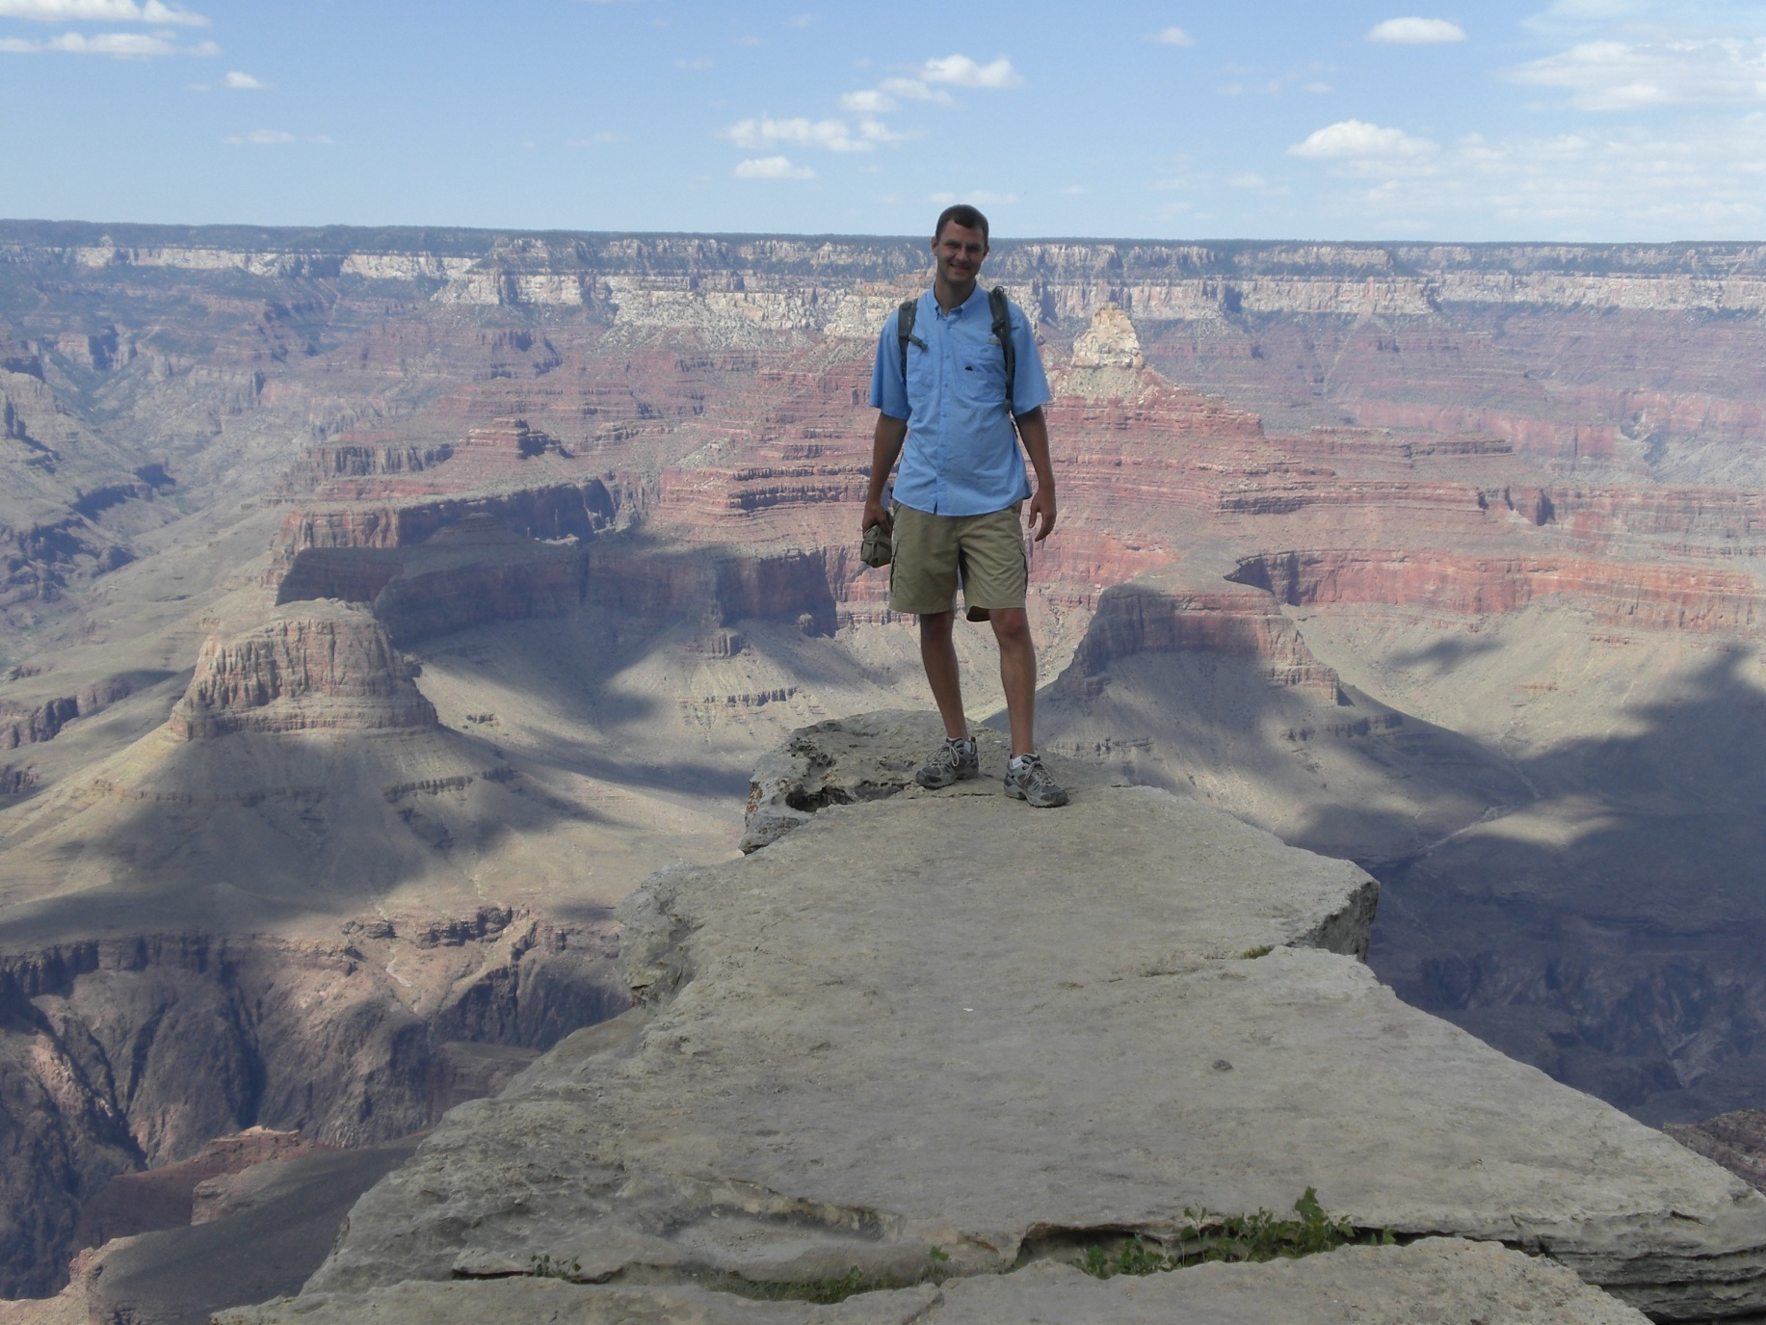
Virtual Road Trips

Slide 7

Virtual Road Trips

Slide 8

Virtual Road Trips

Slide 9
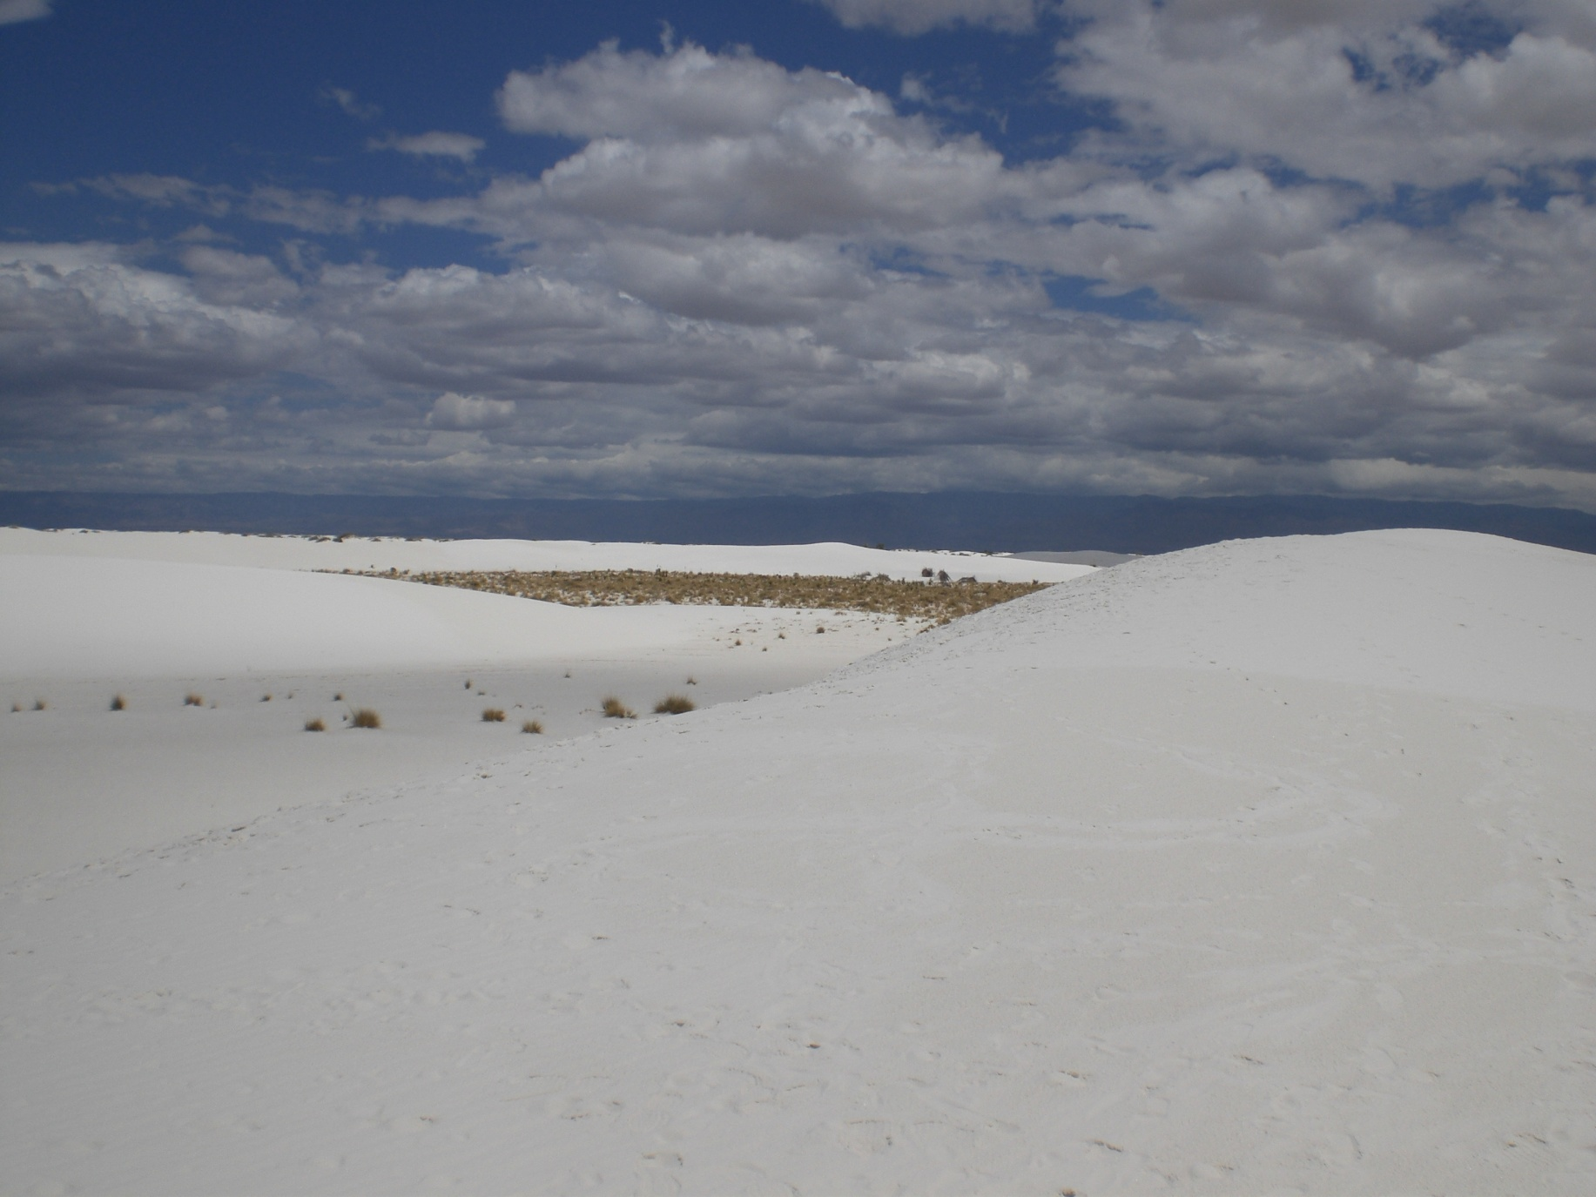
Virtual Road Trips

Slide 10

Virtual Road Trips

Slide 11

Virtual Road Trips

Slide 12

Virtual Road Trips

Slide 13
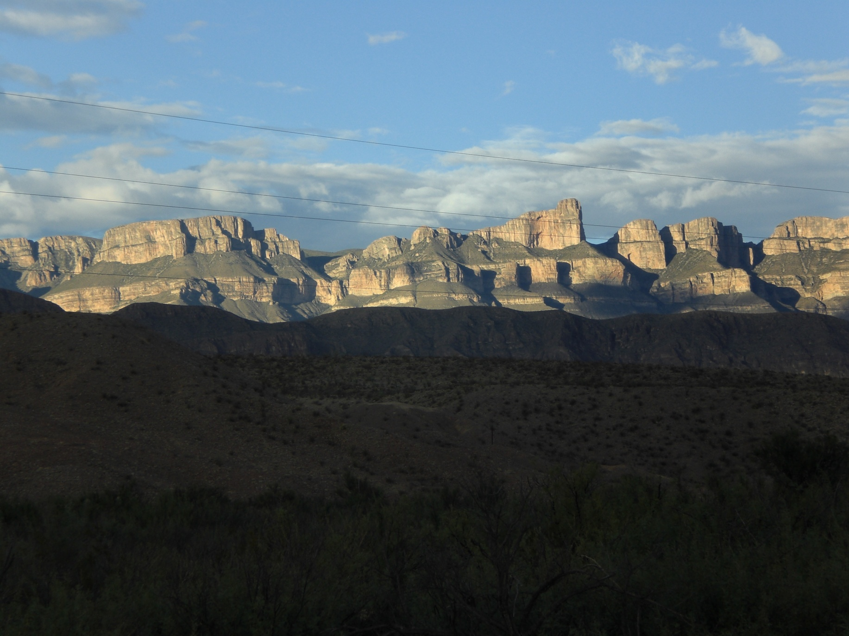
Virtual Road Trips

Slide 14

Virtual Road Trips

Slide 15

Virtual Road Trips

Slide 16

Virtual Road Trips

Slide 17
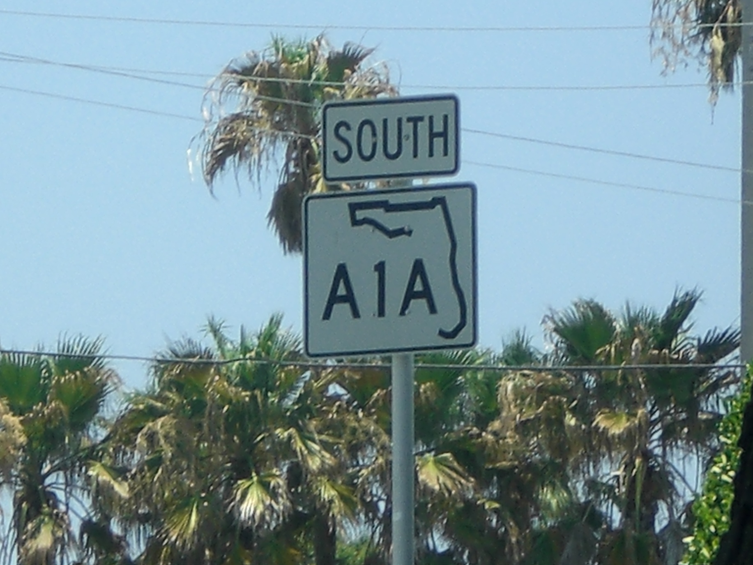
Virtual Road Trips

Slide 18
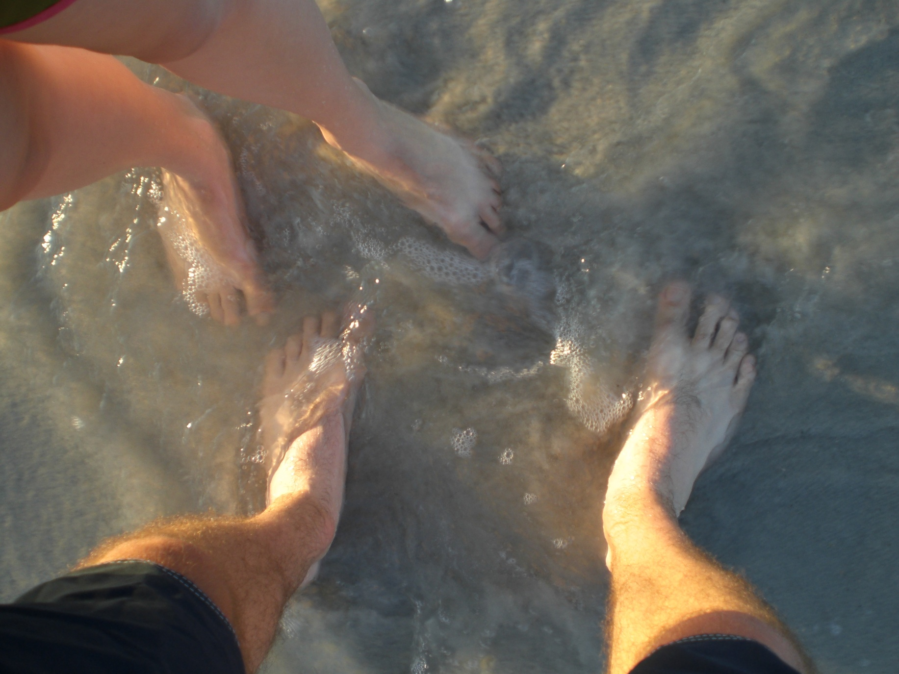
Virtual Road Trips

