Slide 1
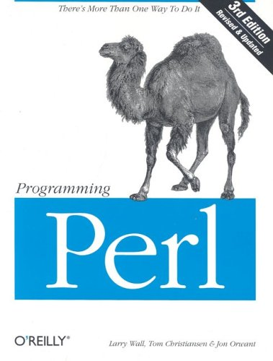
Tommy Gober
COSC 4153
Spring 2009
Assignment #11

Slide 2
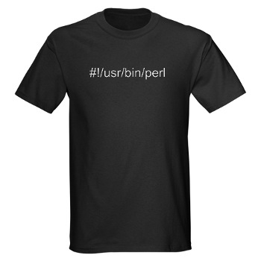
Outline
History
Syntax
Examples
Modules
Practical Usage
Likes and Dislikes
Conclusion
Bibliography

Slide 3
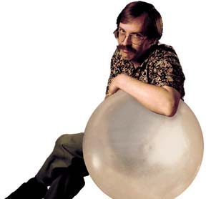
History of PERL
Larry Wall
1987 at Unisys
Originally called “Pearl”, PERL came later
Made as a tool for easy report processing

Slide 4
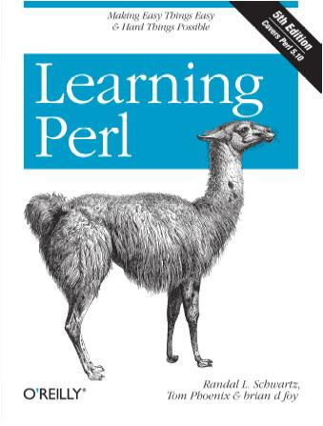
PERL Syntax
$var – scalar
@var – array
$var[2] – element
%var – hash (assoc array)
$var[‘name’] – name element
#comment

Slide 5
Example
#!/usr/bin/perl
print “Hello world\n”;
@names = (“Tom”, “Dick”, “Harry”);
print $names; # 2
print $names[0]; # Tom
foreach(@names){
print $_ . “\n”;
}

Slide 6
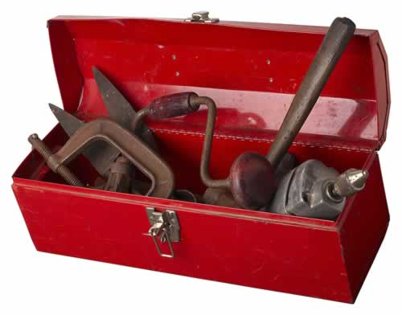
Modules
CPAN has you covered
Usage:
Command line:
cpan –i WWW::Mechanize
In code:
use WWW::Mechanize;
Example

Slide 7
Practical Usage
“duct tape of the internet”
Hassan Schroeder, Sun's first webmaster
“Swiss Army chainsaw of programming languages”
Doug Sheppard, O’reilly publishing
imdb, BBC, del.icio.us, craigslist, /.

Slide 8
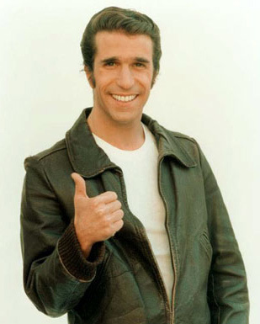
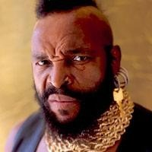
Love/Hate
LOVE
cowboy code
regular expressions
CPAN modules
*nix systems
$_
price
HATE
readability
Win32 perl
going back

Slide 9
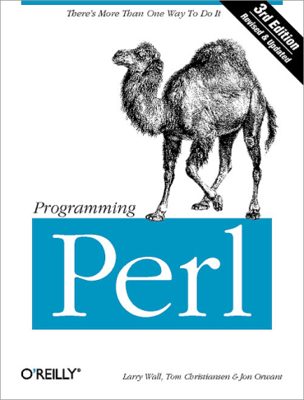
Conclusion
Give it a try
Fun
Free
Well documented
Make your life easier

Slide 10
Bibliography
www.perl.org
www.perl.com
www.perl.com/pub/a/2000/10/begperl1.html
www.oreillynet.com/pub/a/oreilly/perl/news/importance_0498.html
Tommy Gober
paul.krizak@amd.com

